Slide 1
CD COLOURING OF GRAPHS
Thesis review: Graph Coloring and it’s variants

Slide 2
OVERVIEW OF THE THESIS
In this thesis, graph colouring and it’s variants: Star colouring, CD-Colouring, Subcolouring and Strong subcolouring are studied.
The structural as well as algorithmic aspects of these graph colouring problems are explained, and the complexity is studied, classifying them into P, NP and NP complete problems and finding bounds for the complexity.
An exponential χ-binding function is derived for the class of odd-hole free graphs.

Slide 3
OVERVIEW OF THE THESIS
Star colouring: A technique to find the upper bound on the star chromatic number is developed, proving that χs(G) ≤ 4α(G). An algorithm to find a 4α(G) star colouring of a graph G with girth atleast 5 is found.
CD- colouring: Finding the complexity of CD colouring of different graphs, characterize the class of all 3-CD-colourable graphs and prove that k-CD-Colouring is in P for k<=3 and NP complete for k>=3. Proved that ωs(G) ≤ χcd(G). Finding the complexity of finding the cardinality of the maximum subclique in a graph.

Slide 4
Colouring of Graphs
Graph colouring refers to partitioning a graph into independent sets, assigning a colour to each such set. No to adjacent vertices must have the same colour. The chromatic number of a graph, χ(G), is the minimum number of such independent sets.
χ(G) = min{k : G admits a k-coloring}
max{ω(G), |V (G)|/ α(G) } ≤ χ(G) ≤ ∆(G) + 1
Theorem 1.1.1. [74] COLORING of H-free graphs is polynomial-time solvable if H is an induced subgraph of P4 or P3 ∪ K1, and NP-complete for any other H
Odd cycle: χ(G) = 3= ∆(G) + 1
K 3,3,3,3 : ω(G) = |V (G)|/ α(G) = χ(G) =4
ω(G) = order of the largest clique in G (complete subgraph of G); |V (G)| - number of vertices of G; α(G) = vertex independence number; ∆(G) = max degree of G

Slide 5
Star Colouring of graphs
A k-star coloring of a graph G is a k-coloring V1, V2, . . . , Vk such that every component of the graph G[Vi ∪ Vj ] is a star for 1 ≤ i, j ≤ k.
χs(Cn) = 3, if n ≥ 3 and n != 5; = 4, if n = 5
G: C4
:
G: C5
:
χs(G) ≤ χ(G^2 )
χs(Kn,m) = min{m,n}+1
G: K3,4
G: C5
G^2
An optimal star coloring can be found in linear time for a cograph and a tree . It is NP-complete to determine whether star chromatic number is at most three 2 even for bipartite planar graphs .

Slide 6
CD Colouring of graphs
A subset S of the vertex set of a graph G is called a dominating set of G if every vertex not in S has a neighbour in S. A k-coloring V1, V2, . . . , Vk of a graph G is called a k-Dcoloring if for every vertex v ∈ V (G), there exists an i, 1 ≤ i ≤ k, such that Vi ⊆ N[v].
On the other hand, a k-coloring V1, V2, . . . , Vk of a graph G is called a k-CDcoloring if for every Vi , 1 ≤ i ≤ k, there exists a vertex xi such that Vi ⊆ N[xi ].
χd(Pn) = 1 + ┌ n/3┐ ; if n = 2, 3, 4, 5,6, 7
= ┌ n/3┐ ; otherwise.
Each vertex dominates a colour.
Each colour is dominated by a vertex.
χcd(Pn) = χcd(Cn) = ┌ n/2┐ if n ≡ 0, 1, 3 (mod 4)
=n/2 + 1 if n ≡ 2 (mod 4)
Lower bound of the CD-chromatic number: 2 vertices x, y of a graph G are in the same CD-color class of a CD-coloring of G 4 only if d(x, y) = 2 in G. In a subclique, no 2 vertices are at distance 2. The cardinality of a maximum subclique in G is denoted by ωs(G) and ωs(G) ≤ χcd(G).

Slide 7
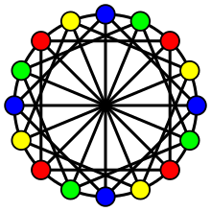
Subcolouring and Strong Subcolouring
A partition of the vertex set of a graph G into k subsets V1, V2, . . . , Vk is called a ksubcoloring of G if Vi is a union of cliques in G for every i, 1 ≤ i ≤ k. (A subcolouring is not necessarily a vertex colouring). The subchromatic number of a graph G is χsub(G) = min{k : G admits a ksubcoloring}.
αs(G) ≤ χsc(G).
Where αs(G) is the max cardinality of a strong set. A strong set S of graph G is a set of vertices such that the dist between any 2 vertices in S is 2 in G.
Strong Subcolouring of K3,3
Subcolouring of K3,3
No two vertices are at a distance of 2 in the graph induced by the colour vertex set, in a subcolouring, (local distance 2 restriction). A strong subcolouring in when no two vertices of the same colour are at a distance 2 in the graph G. (global 2 distance restriction). The strong subchromatic number of a graph G is defined as χsc(G) = min{k : G admits a kstrong subcoloring}.

Slide 8
Relation among subcliques, strong subcolouring and strong sets
Given a graph G, we construct a graph G∗ from G such that V (G∗ ) = V (G) and E(G∗ ) = {xy : d(x, y) = 2 in G}.
Subclique in G <-> Independent set in G* (ex- (A,B,C))
Strong subcolouring in G <-> Colouring in G* (ex- (A,B,C);(D,E))
Strong set in G <-> Clique in G*(ex- (A,D))
A
B
A
B
E
E
C
D
C
D

Slide 9
χ-binding function
A class G of graphs admits a χ-binding function if there exists a function f : N → R + such that χ(G’ ) ≤ f(ω(G’ )), for every induced subgraph G’ of G ∈ G.
Ex: For the class of perfect graphs, wkt χ(G’ ) = ω(G’ ), so f(x) = x.
If there exists a polynomial time approximation to find f( ω(G) ) colouring for a family of graphs G, then there is a polynomial time approximation algorithm for the colouring with performance ratio f( ω(G) ) / ω(G) .
Let F be fixed forest. If G is F-free, then G admits a χ-binding function

Slide 10
Complexity Classes
P: The class of problems that can be solved in polynomial time . O(n^k) for some const k
NP: The class of problems whose solution can be verified in polynomial time.
P is a subset of NP
NP Complete: The class of problems whose status is unknown. They are in NP but it is unkown whether they are in P(No known polynomial time solution exists for them). For a problem to be NPC, it must be both in NP and NP hard i.e. every problem in NP must be reducible to it, or equivalently it must be atleast as hard as any other problem in NP.
We do not know if P=NP. However, if a solution for any problem belonging to the class NP-C is found, a solution can be found for all problems belonging to NP-C and will imply P=NP.
Every optimisation problem : finding a feasible solution with the best value, can be converted into a similar decision problem: with answer yes or no, by imposing a bound on the value to be optimised.

Slide 11
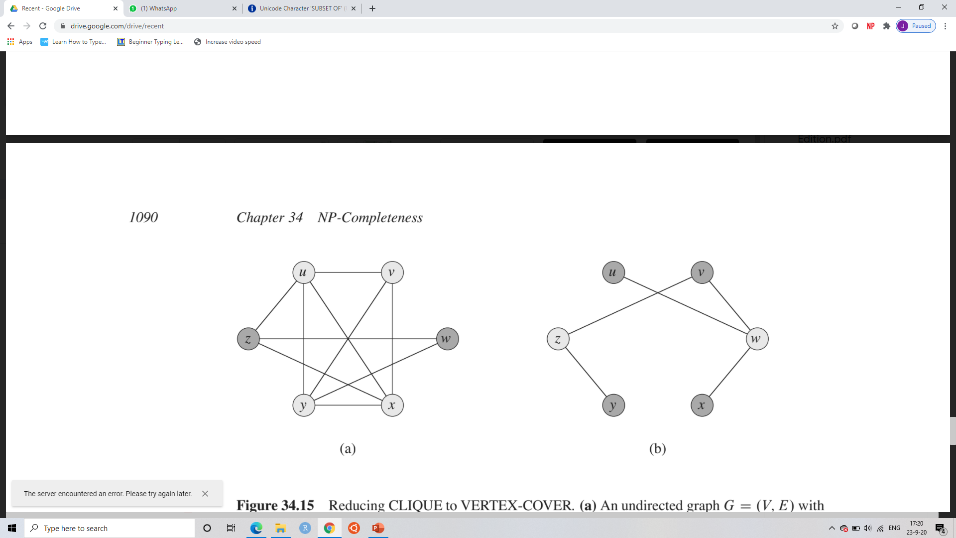
Complexity Classes: Examples
The shortest path problem is in P: we can find the shortest path from a source in a directed graph G=(V,E) in O(VE) time. However, finding the longest path between 2 vertices in G is NP Complete. Merely finding whether G contains a simple path with atleast x no of edges is NPC.
Finding a Euler tour of G is in P,i.e a cycle that traverses each edge of g atleast once is solvable in O(E) time, where as finding a Hamiltonian cycle in G in NP-C.
The clique problem : Finding a clique of maximum size in a graph is NP-C.
The vertex cover problem : Finding a vertex cover of minimum size in G(as an optimization problem) or determining whether a graph G has a a vertex cover of minimum size k(as a decision problem) is also NP-C.
To prove a problem is NP-C, we show that it belongs to NP and there is a polynomial time reduction from a known NP-C problem to the given problem.The clique problem can be reduced to the vertex cover problem. G can be converted into G’ in polynomial time. the graph G has a clique of size k if and only if the graph G’ has a vertex cover of size |V|- k.
Source: Introduction to Algorithms -Cormen

Slide 12
Clique and independent set star partitions
For two disjoint vertex subsets X and Y of a graph G, we write X ← Y if every vertex in Y has at most one non-neighbour in X. That is, |N(y) ∩ X| ≥ |X| − 1, ∀y ∈ Y.
K-clique star partition: V (G) = U Qi, i=1 to k ; Qi is a clique in G for all 1 ≤ i ≤ k ; Qi ← Qj for all 1 ≤ i < j ≤ k.
K-independent set star partition: V (G) = U Si, i = 1 to k; Si is an independent set in G for all 1 ≤ i ≤ k ; every vertex in Sj has at most one neighbour in Si for all 1 ≤ i < j ≤ k.
A graph G admits a k-clique star partition if and only if Gc admits a k-independent set star partition.
Q1,Q2,Q3 are cliques
Q1 <- Q2,
Q2 <- Q3,
Q1 <- Q3
S3
Q1,Q2,Q3 are independent sets
Each vertex in S2 has atmost 1 neighbour in S1
Each vertex in S3 has atmost 1 neighbour in S2.
Each vertex in S3 has atmost 1 neighbour in S1
Q3
Q1
S1
S2
Q2

Slide 13
Star Colouring of graphs with girth atleast 5
Finding an upper bound for the star chromatic no. of graphs with girth atleast 5.
A graph has girth atleast 5 if and only if it is it {K3,C4} free. So, we need to find the bound of χ(G) for a {K3,C4} free graph. Also, if G is {K3,C4} free, G’ is {3K1,2K2} free, and a clique star partition on G’ is an independent set star partition of G.
We relate the χ(G) to k, where G admits a k-independent set star partition, and find the k – independent set star partition of G by finding a k-clique star partition for G’ in polynomial time.
We develop an method to find the clique star partition of a {3K1,2K2,C4} free graph and further generalise it to develop an algorithm for the clique star partition of a {3K1,3K2} free graph.

Slide 14
Observations required for the proof
Let H be an induced subgraph of a graph G and let X and Y be two disjoint subsets of V (H). Then X ← Y in H if and only if X ← Y in G.
If a graph G admits a k-clique star partition, then it also admits a (k + 1)-clique star partition. (Taking the k+1 th clique as ø)
If a graph G admits a k-clique (respectively independent set) star partition, then every induced subgraph of G also admits a k-clique (respectively independent set) star partition. (Take the intersection of H with every clique/independent set)
G
H

Slide 15
Relation between χ(G) and k
Lemma: If G admits a k-independent set star partition, then χs(G) ≤ k.
The converse is not true.
Observation: If a graph G admits a k-clique star partition, then χs(Gc ) ≤ k.
Note:testing whether a graph G admits a 2-independent set star partition can be done in O(n+m) time, where n and m denote the numbers of vertices and edges of G, respectively.
χs(G) = 3
4-independent set star partition

Slide 16
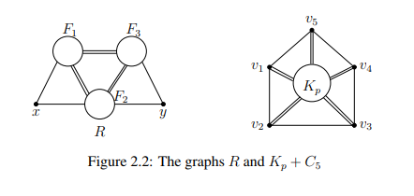
Clique star partition of {3K1, 2K2, C4}-free graphs
Theorem: If G is a {3K1, 2K2, C4}-free graph, then G is isomorphic to either Kp + C5 (p ≥ 0), or an induced subgraph of R, where V (R) = {x, y} ∪ F1 ∪ F2 ∪ F3 such that F1∪F2∪F3 is a clique, {x}⊕(F1∪F2), {y}⊕(F2∪F3), {x} F3, {y} F1, and xy /∈ E(G) .
Proof:
Step 1:Suppose G induces a C5 with vertex set V (C5),then every vertex x in V (G)\V (C5) is adjacent to every vertex in V (C5) and is a clique.
Step 2: If it doesn’t induce C5, it is a split graph.
Independent set has size atmost 2. So, it is isomorphic to R.
Every {3K1, 2K2, C4}-free graph admits a 4-clique star partition
Check if G is Bipartite in 0(n+m), and find the partition in 0(n^2)

Slide 17
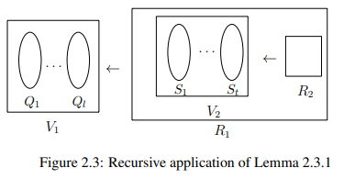
Clique Star Partition Lemma
Lemma: If G is a graph with a vertex partition V (G) = V1 ∪ R1 such that
1. Q1, Q2, . . . , Ql forms an l-clique star partition of G[V1],
2. G[R1] admits a p-clique star partition, and
3. Qi ← R1 in G for all 1 ≤ i ≤ l,
then G admits an (l + p)-clique star partition.
This can be extended recursively:
Theorem: Let G be a graph with a vertex partition V (G) = V1 ∪ V2 ∪ . . . ∪ Vk and let Ri = Vi+1 ∪ Vi+2 ∪ . . . ∪ Vk for all 1 ≤ i ≤ k − 1. Suppose that
1. Qi 1 , Qi 2 , . . . , Qi li forms an li-clique star partition of G[Vi ] for all 1 ≤ i ≤ k,
2. Qi j ← Ri in G for all 1 ≤ j ≤ li and 1 ≤ i ≤ k − 1 ,
Then G admits an (l1 + l2 + . . . + lk)-clique star partition.

Slide 18
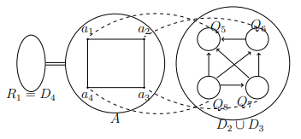
Clique star partition of a {3K1, 2K2}-free graph
First, check if G is C4 free. If it is, we can find a 4-clique star partition in O(n^2) time.
If it is not C4 free, if G induces a C4, then find a vertex partition V (G) = V1 ∪ R1 as in the previous lemma. We can then find an 8-clique star partition for V(G), take R as the new G and use the same algorithm for R.
Lemma: Let G be a {3K1, 2K2}-free graph and let A ⊆ V (G) in which G[A] ∼= C4. Then V (G) can be partitioned as V (G) = V1 ∪ R1 such that
A ⊆ V1 and A ⊕ R1 in G,
G[V1] admits an 8-clique star partition Q1, Q2 . . . , Q8, and
Qi ← R1 in G for all 1 ≤ i ≤ 8.
V (G)\A can be partitioned as V (G)\A = D2 ∪ D3 ∪ D4 such that every vertex in Dj is adjacent to exactly j vertices in A in G. So V (G) = A ∪ D2 ∪ D3 ∪ D4.
Let V1 = A ∪ D2 ∪ D3 and R1 = D4

Slide 19
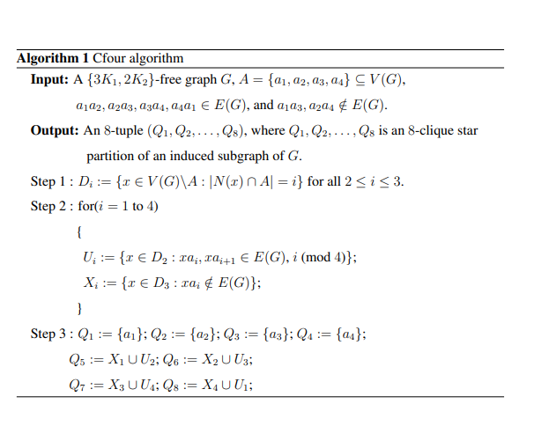
Clique-star algorithm
Using the C four algorithm, we can find an 8 clique star partition of G.
Let V (G) = V1 ∪ V2 ∪ . . . ∪ Vk ∪ V0
For each Vi that induces a C4 graph, we can find an 8 – clique star partition and the new graph G induced by
V (G) = G/(V1 ∪ V2 .. ∪ Vi) = Ri again goes through the same algorithm till we reach V0 which is C4 free.
Detecting whether C4 is induced takes 0(n^4) time and finding the 8-clique star partition takes O(n+m) time. This is done for each of the k iterations. Hence the algorithm takes O(n(N^4+n+m)) = O(n^5) time.
G admits an 8k-clique star partition if V0 = ∅ and (ii) G admits an (8k + 4)-clique star partition if V0 != ∅.

Slide 20
Bound for number of iterations k
Lemma: If the Clique-star algorithm partitions the vertex set of a {3K1, 2K2}- free graph G as V (G) = V1 ∪ V2 ∪ . . . ∪ Vk ∪ V0, then (i) 2k ≤ ω(G) if V0 = ∅, and (ii) 2k + 1 ≤ ω(G) if V != ∅.
Proof:
Ai ⊕ Aj in G for all 1 ≤ i < j ≤ k and Ai ⊕ V0 in G for all 1 ≤ i ≤ k.
Consider the graph H = G[A1∪A2∪. . . Ak∪V0]. G[Ai ] ∼= C4 and ω(G[Ai ]) = 2
Hence ω(H) = ω(G[A1])+ω(G[A2])+. . .+ω(G[Ak])+ω(G[V0]) = 2k +ω(G[V0]).
If V0 = ∅, 2k = ω(H) ≤ ω(G). If V0 != ∅, and 2k + 1 ≤ 2k + ω(G[V0]) = ω(H) ≤ ω(G).

Slide 21
4ω(G)-clique star partition.
Theorem : If G is a {3K1, 2K2}-free graph, then G admits a 4ω(G)-clique star partition.
Case 1: V0 = ∅: 2k ≤ ω(G) , so 8k ≤ 4ω(G)
Case 2: V0 != ∅. 2k + 1 ≤ ω(G), so 8k + 4 = 4(2k + 1) ≤ 4ω(G)
Since G is {3K1, 2K2} free, G’ is {K3,C4} free. Also, ω(G) = α(G’).
If G is a {K3, C4}-free graph, then G admits a 4α(G)-independent set star partition and χs(G) ≤ 4α(G).
Further, G is a graph with girth at least five if and only if G is {K3, C4}-free.
Theorem: Let G be a graph with girth at least five. Then (1) χs(G) ≤ 4α(G) and (2) there is an O(n^ 5 ) time algorithm to find a 4α(G)-star coloring of G, where n is the number of vertices in G.
Since the graph C5 is {K3, C4}-free and χs(C5) = 4 = 2α(C5)
Conjecture : If G is a graph with girth at least four, then χs(G) ≤ cα(G), for some constant c.

Slide 22
Complexity of CD Colouring of Graphs
A) Split graphs and Chordal Graphs
Thm: If G is a connected split graph, then an optimal CD-coloring of G can be found in O(n^2 ) time, where n denotes the number of vertices of G and χcd(G) = ω(G).
Proof:
A split graph consists of a complete graph Kp(maximal clique) and an independent set I.
For each y of I, find the min i(mod p) s.t. yxi−1 ∈/ E(G) and yxi ∈ E(G).
Let Ii be the set of all y where I is the min such integer. Then the partition Vi = {xi-1}U Ii is a CD colouring of G and xi dominates Vi. It can be found in O(n^2) time. Since ω(G) = p, χcd(G) <= p = ω(G). Also , wkt χcd(G)>= ω(G). So, χcd(G) = ω(G). And this is an optimal colouring.

Slide 23
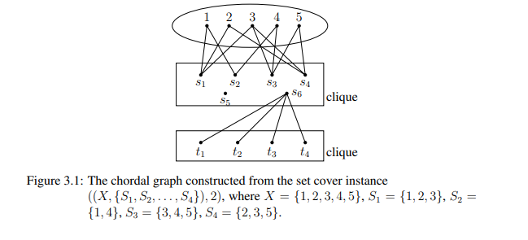
Complexity of CD Colouring of Graphs
A) Split graphs and Chordal Graphs
Thm: CD colouring is NP complete for chordal graphs
Proof: We find a polynomial time reduction from a set cover problem to a CD colouring of a chordal graph.
Let ((X, {S1, S2, . . . , Sm}), k) be an instance of SET COVER. It is transformed into a CD-COLORING instance (G, k’ ) as follows. The graph G = (V, E) we construct has V = X ∪ {s1, s2, . . . , sm, sm+1, sm+2, . . . , sm+k} ∪ {t1, t2, . . . , tm} and E = {{si , sj} | i, j = 1, 2, . . . , m + k and i 6= j} ∪ {{si , x} | x ∈ X, 1 ≤ i ≤ m, and x ∈ Si} ∪ {sm+k, ti} | i = 1, 2, . . . , m} ∪ {{ti , tj} | i, j = 1, 2, . . . , m and i 6= j}. The parameter k’ is set to m + k.
((X, {S1, S2, . . . , Sm}), k) is a YES instance of SETCOVER if and only if (G, m + k) is a YES instance of CD-COLORING.

Slide 24
Complexity of CD Colouring of Graphs
B) Claw-free graphs
For a claw free graph, finding the optimal colouring is NP complete but finding the optimal CD colouring is in P with time O(n^3)
Construct graph G∗ such that V (G∗ ) = V (G) and E(G∗ ) = {xy : d(x, y) = 2 in G}.
k-CD Colouring of G <-> Matching of size n-k in G*. So, find the maximum matching of G* (in O(√nm time).G can be converted to G* in O(n^3) time .
Thm:If COLORING for H-free graphs is NP-complete, then CD-COLORING for (K1 + H)-free graphs is also NP-complete.
Thm: CD-COLORING for K1,p-free graphs is in P for p ≤ 3 and NPcomplete for p > 3.
Thm:CD-COLORING for graphs G is in P if α(G) ≤ 2 and NP-complete if α(G) ≥ 3.

Slide 25
Complexity of CD Colouring of Graphs
C) Triangle-free graphs and bipartite graphs
The total domination number of a graph G,γt(G) = The minimum cardinality of a set S such that every vertex in V has a neihgbour in S.
Theorem: For a triangle-free graph G without isolated vertices, χcd(G) = γt(G).
Proof: A TD set can be obtained from a CD colouring by taking all dominating vertices and taking the neighbour of the dominating vertex if a singleton colour set dominates itself. Hence, Thm: For a triangle-free graph G without isolated vertices, χcd(G) <= γt(G). For a triangle free graph, given a TD set S {v1,v2..vk}, for each vi in S, N[vi] is an independent set, and hence can be used to construct the colour classes. Hence, χcd(G) >= γt(G).
Bipartite graphs, trees are triangle free. Hence, Total Domination is NP complete for bipartite graphs, hence is CD colouring is also NP complete. Total Domination is linear time solvable for trees, CD colouring is linear time solvable.
B) P4 free graphs and H free graphs
If G and H are two vertex disjoint graphs with at least one vertex each, then χcd(G + H) = χ(G) + χ(H) = χ(G + H). Connected P4 free graphs can be written as a join of 2 P4 free graphs, so χcd(G) = χ(G) and can be found in O(n+m) time. χcd(G) = summation ( χ(Gi) )= summation(ω(Gi)) where Gi are components of G.
Theorem: For a graph H, CD-COLORING for the class of H-free graphs is polynomial time solvable if H is an induced subgraph of P4 or P3 ∪ K1 or K1,3, and NP-complete for any other H.

Slide 26
Complexity of CD Colouring of Graphs
E) Double Split graphs
A graph G = (V, E) is double-split if its vertex set can be partitioned into two sets A and B such that the following hold: (i) G[A] is a disjoint union of edges (ii) G[B] is the complement of a disjoint union of edges, (iii) for all x ∈ B and all adjacent u, v ∈ A, x is adjacent to exactly one of u and v, and (iv) for all u ∈ A and all non-adjacent x, y ∈ B, u is adjacent to exactly one of x and y.
Two vertices u, v ∈ B are called twins of A ⊆ V (G) if N(u) ∩ A = N(v) ∩ A . A double-split graph G admits a twin of A if and only if χcd(G) = m+1.
For a double-split graph G with |A| ≥ 4 and |B| ≥ 4, m + 1 ≤ χcd(G) ≤ m + 2.
CD-COLORING for a double-split graph G can be solved in O(n 3 ) time, where n denotes the number of vertices of G.

Slide 27
1
2
2
2
2
3
3
3
1
1

Slide 28
v0
v1
a
1
0
1
v7
1
2
v2
a
f
g
v6
2
0
2
e
2
e
b
0
1
v3
b
h
v5
v4
d
c
j
i
4
3
d
c

